Slide 1
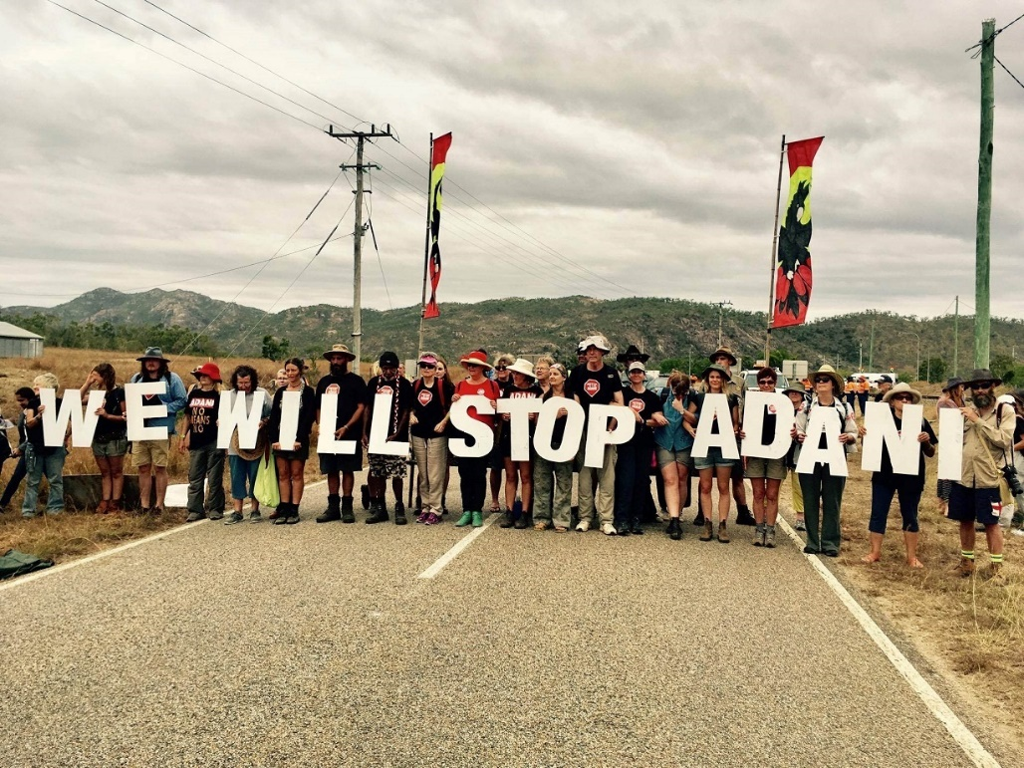
Media – social & traditional
How to get our message out there
This is a slidehow from an interactive workshop we have run You may find these dot points useful, along with other resources and we will be adding more detail by mid 2024

Slide 2
What is your message
A limited body of truthful information which is consistently conveyed by an organisation in order to provide the persuasive reasons for an audience to choose and act on behalf of their issue or cause.
(Paul Tully, via CAP)

Slide 3
How do we multi task content?
Frontline Activists are often short on time and resources – this was a discussion point as part of a workshop with digital storytellers about how we can use our phones for photo, video, for social media, as well as and to provide exclusive footage to TV news organisations if we can ensure a decent quality

Slide 4
Media example - discussion

Slide 5
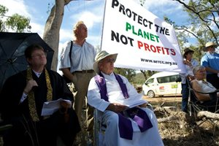
DISCUSSION
What makes an effective messenger?

Slide 6
What makes an effective messenger
Relatable
Authentic
Knows their stuff (but doesn’t have to know everything)
Has an emotional connection to the issue

Slide 7
Basic media tips
Discussion within group

Slide 8
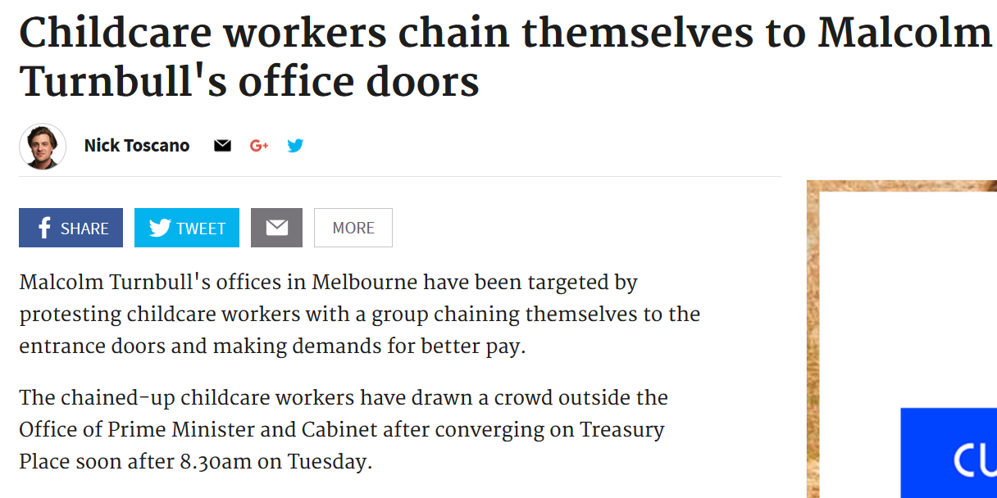
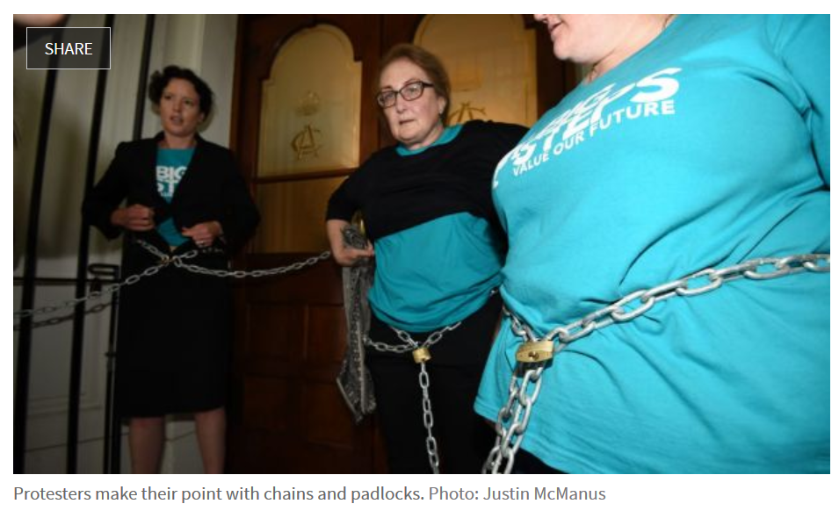
CASE STUDY EXAMPLE

Slide 9
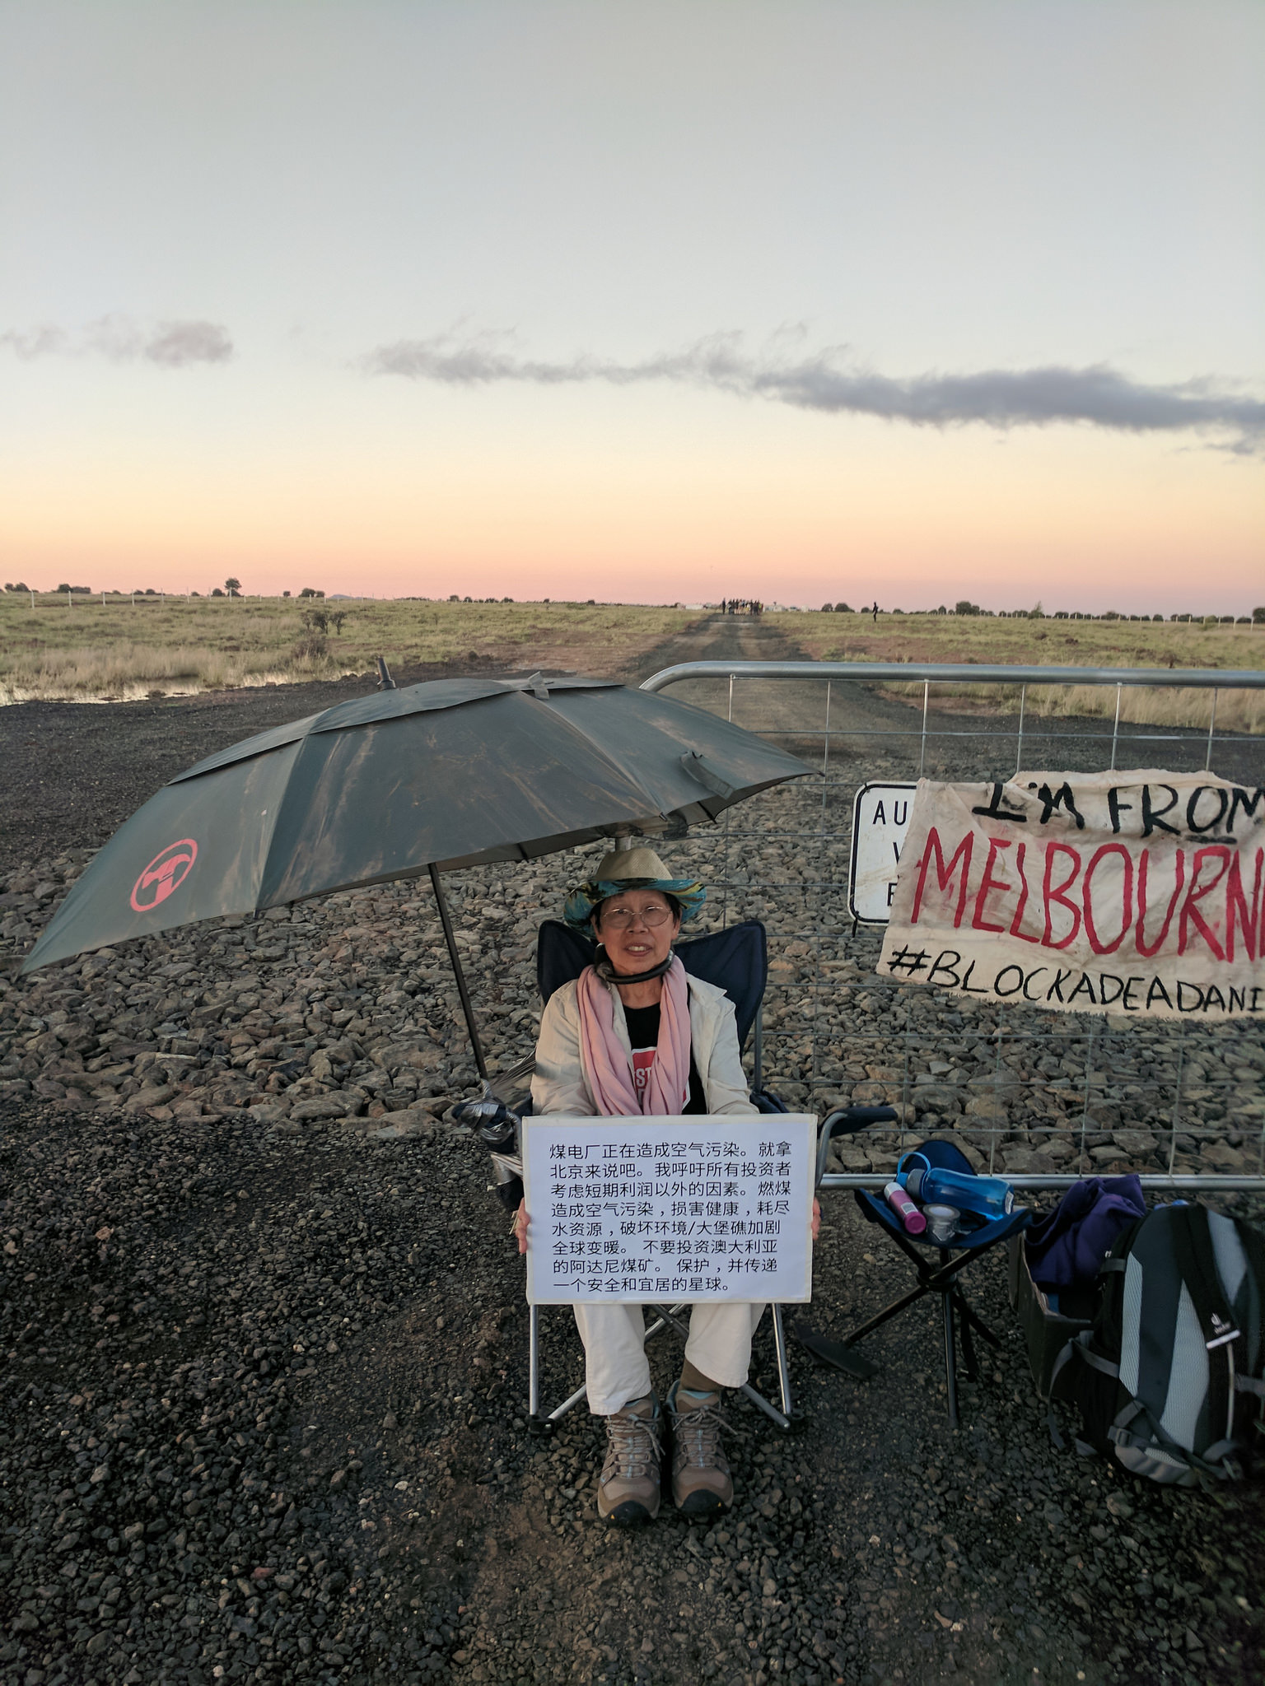
Media basics
All media is not good media
Prepare – get lists, check with friendly NGO’s – keep notes, and track personal
connects
Media release (follow the basic template, keep it simple, use the reverse triangle and give useable quotes for online news)
SPRUIK IT – media organisations get 100s releases a day – call and sell your story!
Remove barriers - ie, give them good content, “movement and colour” and meet and accompany them if discreet/covert action

Slide 10
Talking to camera
Talking to camera
Look at the person filming, not down the barrel
Take off sunglasses and anything else distracting (outrageous hat etc)
Talk in complete sentences … answer the question in the sentence…
Ie -Why are you here today? We are here today to…
Open body language

Slide 11
Media basics
Sound bites and key messages
TV interviews and visual presentation
‘ good talent’
Dealing with difficult questions
Interview practice

Slide 12
Your message
How do you talk about your campaign within a single action/event

Slide 13
Media for civil disobedience
Talk about WHY you are there, not HOW you got there
Prepare for tricky questions, and prepare to either – answer what you want to, or pivot
Common scenarios… security risks, how did you gain access
They can only use what you give them – we need to be pragmatic, we know the way they work and that vested interests may be involved in the editing process (even if journalists are reporting in good faith)
Reference media/direct action resource
Practice scenario
Pick a single theme of your campaign – Ie, funding for family violence, calling on a Minister to commit to refusing a mine approval, or the closure of a refugee centre… and your target decision maker…

Slide 14
Good images for socials – Live SOCIALS
Checklist for live reporting

Slide 15
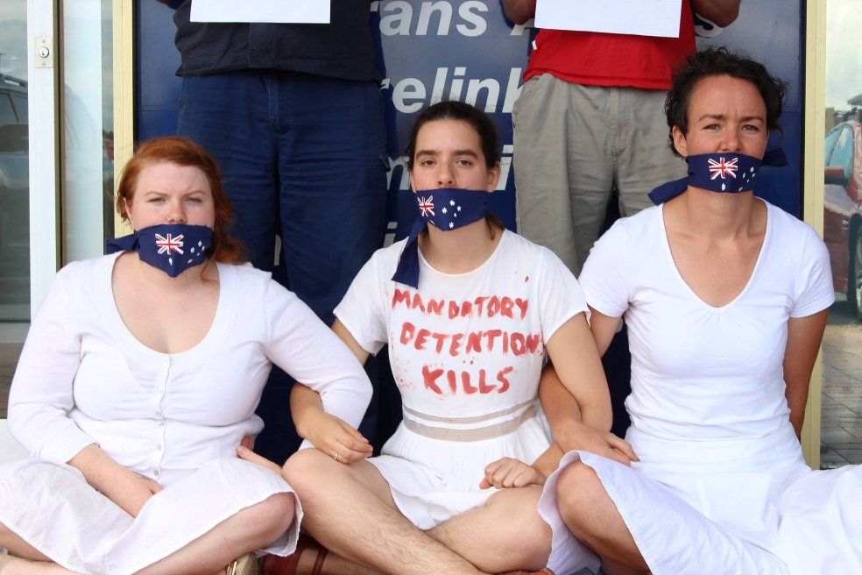
Basic tips for twitter & BEYOND
WHY IS IT AN OPPORTUNITY?
Two way conversation… It is the social media platform with the biggest drop off. People don’t follow you unless you have something to say. You have to put in effort for a period of time
Access to journalists
MPs pay attention
It also drives traditional media
Help each other out – digital solidarity
Good hashtags – are self explanatory, short determined on your terms, announced regularly during events
Feed the beast
Tell stories
Don’t just take crowd pictures, tell stories of people
Two simple tips to make life easier: multiple apps to show lists, scheduling
We aren’t calling it X! These tips are applicable to a range of short form content platforms

Slide 16
Building a story
Why should people care? Do you look like you care?
An action should have a beginning, middle and END… who can best tell the story of the day
Set up shots, telling the story, placing yourself in the frame… why are you there? How is it relevant?
Middle… getting different perspectives, narrating the action as it unfolds (we are occupying the space… this is our core message and ask… they have closed for the day… talking to staff… getting comfy… police are here! We are staying strong)
End strong – always end well. On your terms, don’t let things fade away. Remind people of call to action

Slide 17
FACEBOOK QUICK TIPS
PAGES
Organic reach is tiny
Small money can boost well
Ask allies to share, tag and give credit
Take photos with lots of folk, get them to tag themselves
Video is king, then photos
Facebook live: stay steady, be prepared, 2 ppl if possible, don’t pan wildly
GROUPS
Good for active allies and new people to campaigns
Get people involved, ask questions
Get people to signal boost all posts and “troll patrol”
PERSONAL
Make better use of your personal page
Set your campaign shares to “public”
Tag friends, be judicious in your asks

Slide 18
How to get your story out there, now its done
Do an assessment of your social media assets – what is your reach? Who are your allies?
Prepare the best format for each platform
Store for re-use
Make a list of distro points
Email lists
Facebook groups
Facebook pages
Twitter, Bluesky, Threads accounts (DM contacts and ask them to share, if possible, prepare tweets)
Make personal asks – via text, DM, email or phone
Insta and tiktok for video

